Slide 1
DAY 10 PPT

Slide 2
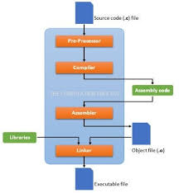
WHAT IS PRE PROCESSOR?
Unique to the C family; other languages don't have this Processes #include, #define, #if, macros Combines main source file with headers (textually) Defines and expands macros (token- based shorthand) Conditionally removes parts of the code (e.g. specialize for Linux, Mac, ...) Removes all comments Output looks like C still

Slide 3
GDB
In Linux, GDB (GNU Debugger) is a powerful tool for debugging programs written in C, C++, and other supported languages. Here are some common commands used within GDB:
break [location]: Set a breakpoint at a specific location, such as a line number, function name, or memory address.
Example: break main sets a breakpoint at the beginning of the main function.
run [args]: Start running the program with optional arguments.
Example: run input.txt runs the program with input.txt as an argument.
continue: Continue running the program until the next breakpoint.
step [count]: Execute the current line of code, stepping into function calls if any.
Example: step executes the current line; step 5 executes the next 5 lines.
next [count]: Similar to step, but does not step into function calls, treating them as a single step.
Example: next executes the current line; next 3 executes the next 3 lines.

Slide 4
print [expression]: Evaluate and print the value of an expression.
Example: print x prints the value of variable x.
info breakpoints: Show information about all active breakpoints.
delete [breakpoint_number]: Delete a breakpoint by its number.
Example: delete 1 deletes breakpoint number 1.
backtrace: Show the current function call stack.
finish: Continue execution until the current function returns.
watch [expression]: Set a watch point on a variable, stopping execution when its value changes.
quit: Exit GDB.
These are just a few basic commands to get you started. GDB has many more commands and features for advanced debugging tasks. You can access GDB's documentation using the help command followed by the command or topic you're interested in, e.g., help break, help run, etc.

Slide 5
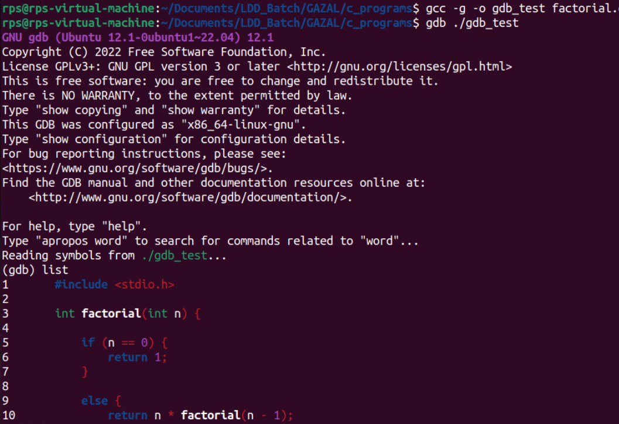
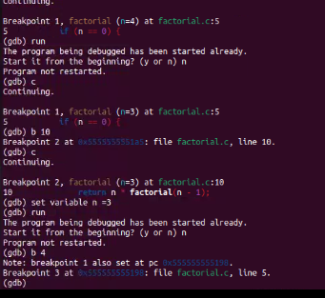
USING FEW CMDS WITHIN GDB

Slide 6
Make file
The make command in Linux is a powerful tool used for automating the build process of software projects. It reads a file called Makefile, which contains instructions on how to compile and link the project's source code files. Here's a basic overview of how the make command works:
Makefile: A Makefile is a text file that contains rules and dependencies for building a project. It consists of targets, dependencies, and commands to execute.
Targets: Targets represent the different components of the project that can be built. These are typically named after the executables or libraries that the project produces.
Dependencies: Dependencies are the files or other targets that a target depends on. If a dependency is updated, the corresponding target will be rebuilt.
Commands: Commands are the shell commands that make executes to build the targets. These commands are typically compiler invocations or other build tools.

Slide 7
out.o: src.c src.h
$@ # "out.o" (target)
$< # "src.c" (first prerequisite)
$^ # "src.c src.h" (all prerequisites)
%.o: %.c
$* # the 'stem' with which an implicit rule matches ("foo" in "foo.c")
also:
$+ # prerequisites (all, with duplication)
$? # prerequisites (new ones)
$| # prerequisites (order-only?)
$(@D) # target directory

